Slide 1
Weiming HPC Training Camp
×
LCPU AI Infra Seminars
北京大学未名超算队
北京大学学生 Linux 俱乐部

Slide 2
2. Memory Abstraction & Hierarchy
Zhou Yuxuan
2026. 07. 29
Weiming Supercomputing Team
Linux Club of Peking University

Slide 3
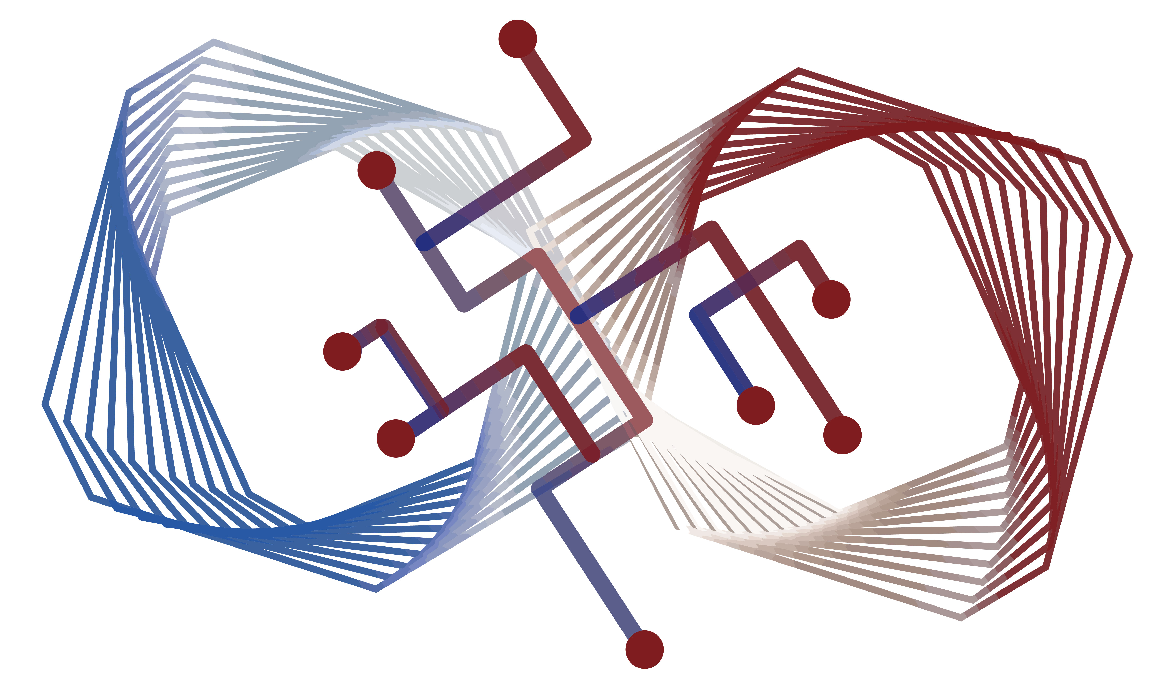
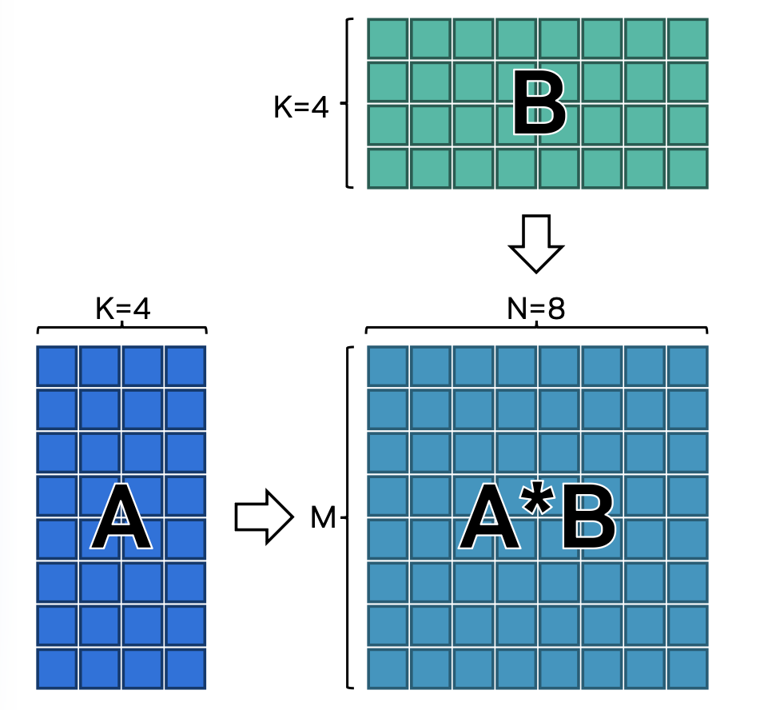
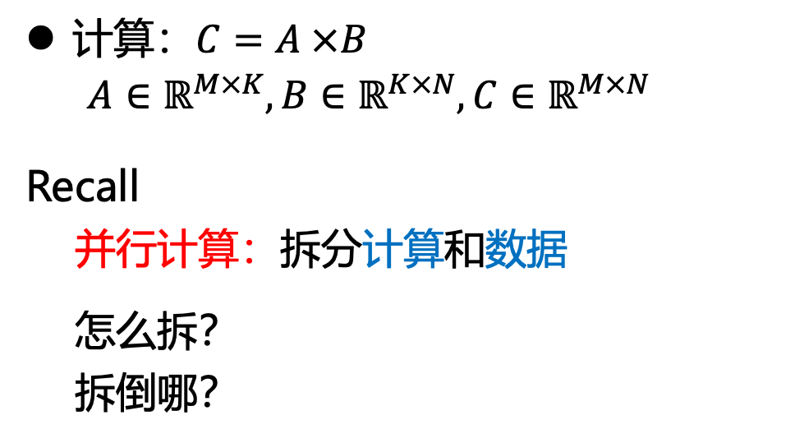
矩阵乘法 GENERAL MATRIX MUTIPLICATION
计算：$C=A ×B$
$A∈ℝ^{M×K},B∈$ $ℝ^{K×N},C∈ℝ^{M×N}$
Recall
并行计算：拆分计算和数据
怎么拆？
拆倒哪？

Slide 4
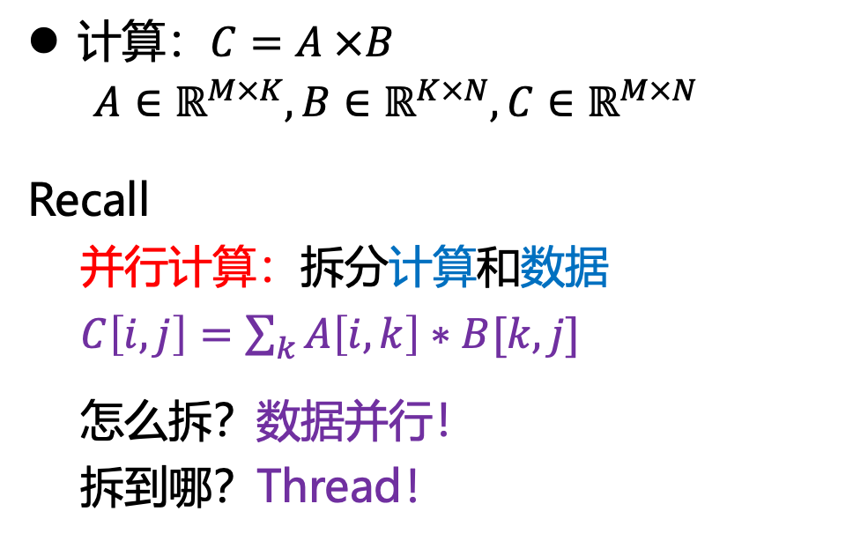
矩阵乘法 GENERAL MATRIX MUTIPLICATION
计算：$C=A ×B$
$A∈ℝ^{M×K},B∈$ $ℝ^{K×N},C∈ℝ^{M×N}$
Recall
并行计算：拆分计算和数据
$C\left[i, j\right]=\sum_{k}{A\left[i,k\right]∗B[k,j]}$
怎么拆？数据并行！
拆到哪？Thread！
SIMT ！

Slide 5
矩阵乘法 GENERAL MATRIX MUTIPLICATION
__global__ void gemm_naive(
const float* __restrict__ A,
const float* __restrict__ B,
float* __restrict__ C, # restrict 的好处？
int M, int N, int K
) {
int row = blockIdx.y * blockDim.y + threadIdx.y;
int col = blockIdx.x * blockDim.x + threadIdx.x;
if (row >= M || col >= N) return;
float acc = 0.0f;
for (int k = 0; k < K; ++k) {
acc = fmaf(A[row * K + k], B[k * N + col], acc);
}
C[row * N + col] = acc;
}
dim3 block(16, 16); # 二维 CTA / Thread Block ？
dim3 grid(ceil_div(N, 16), ceil_div(M, 16));
gemm_naive<<<grid, block>>>(A, B, C, M, N, K);
计算：$C=A ×B$
$A∈ℝ^{M×K},B∈$ $ℝ^{K×N},C∈ℝ^{M×N}$
Recall
并行计算：拆分计算和数据
$C\left[i, j\right]=\sum_{k}{A\left[i,k\right]∗B[k,j]}$
怎么拆？数据并行！
拆到哪？Thread！
SIMT ！

